Slide 1

C# Basics

Slide 2
Introduction to C#
C# is designed by Anders Hejlsberg from Microsoft in 2000
C# is general purpose programming language
C# is object oriented (class-based) programming language
C# is used on .NET platform
C# can be used for writing of Console, Desktop, Widows Services, Web apps, Mobile apps, Games and much more.
C# supports static typing, functional programming, generics and more features
C# and Microsoft documentation are generally quite good
C# documentation: https://docs.microsoft.com/en-us/dotnet/csharp/

Slide 3

Anders Hejlsberg
Danish software engineer who co-designed several programming languages and development tools. He is the original author of Turbo Pascal and co-chief of Delphi. Currently works in Microsoft as a lead architect and core developer of TypeScript.

Slide 4
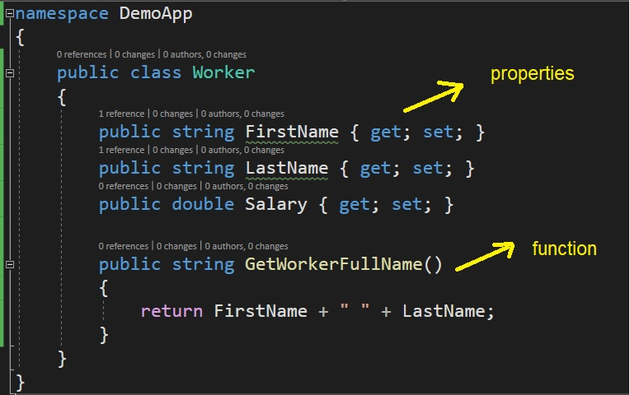
C# is object oriented programming language

Slide 5
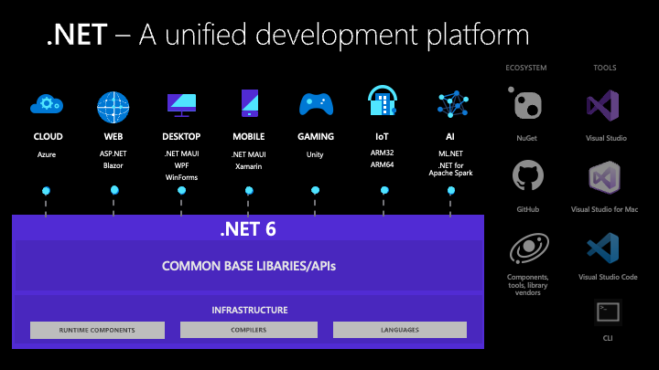
.NET platform /whole new world/

